Slide 1
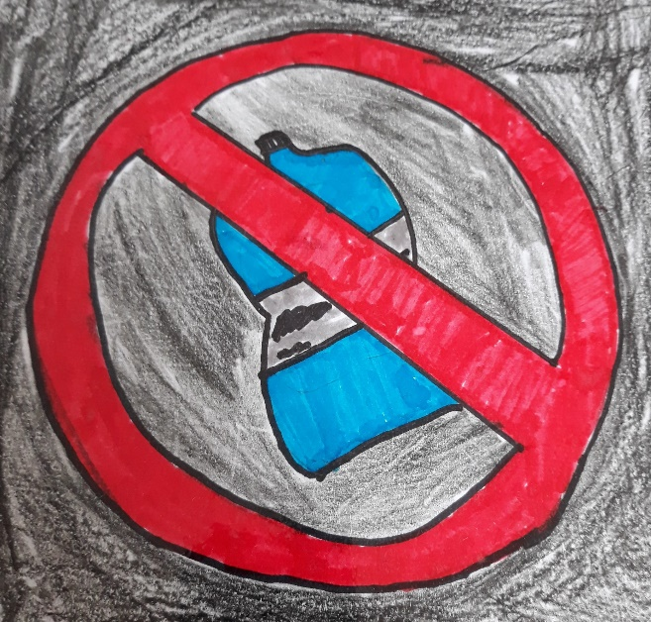
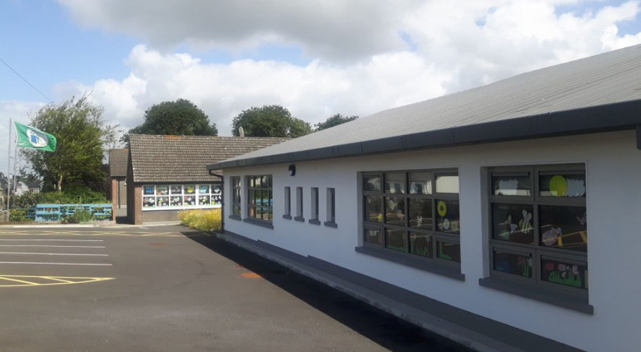
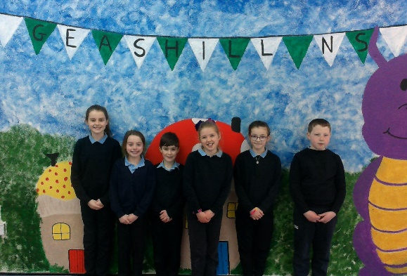
SEAI One Good Idea Competition BottleBusters

Slide 2
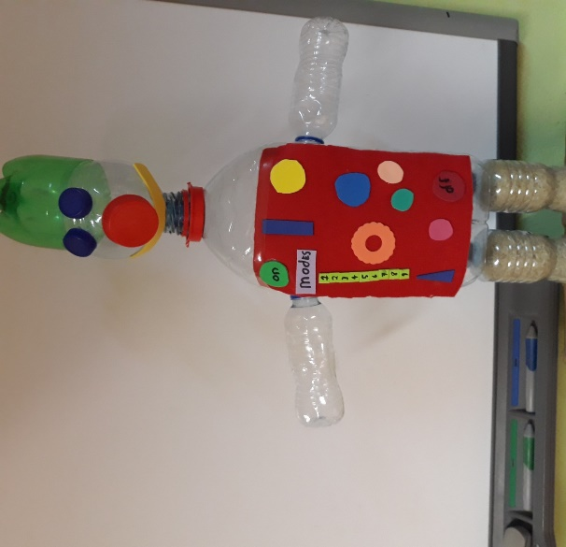
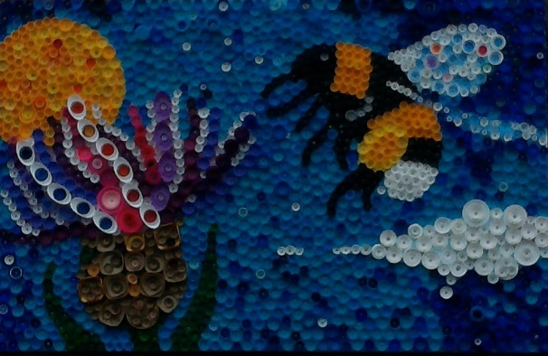
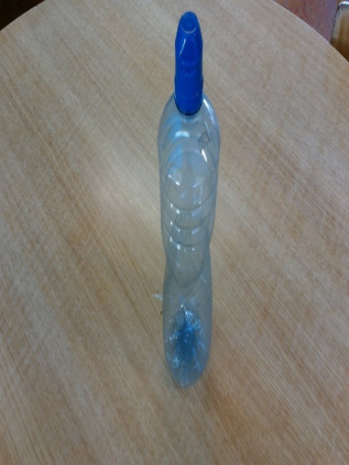
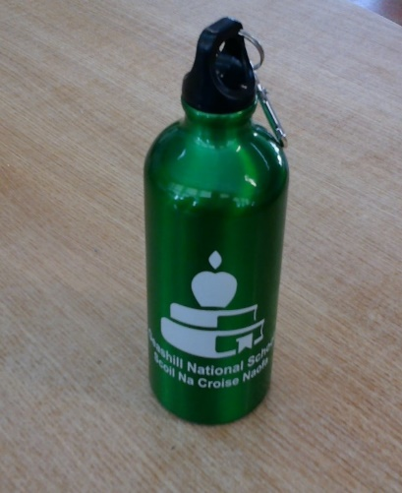
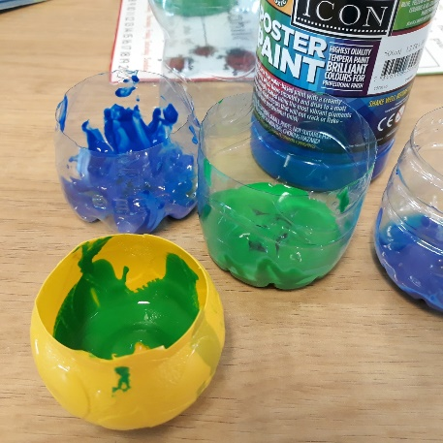
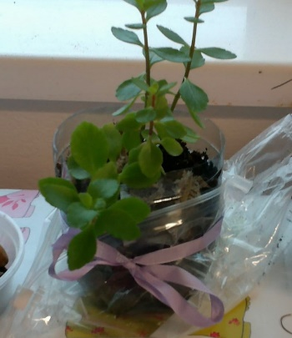
Our Idea
To eliminate the use of single-use plastic bottles in school and to replace these plastic bottles with re-usable aluminium ones.
Don’t forget to re-use bottles you may find!!
Make the change

Slide 3
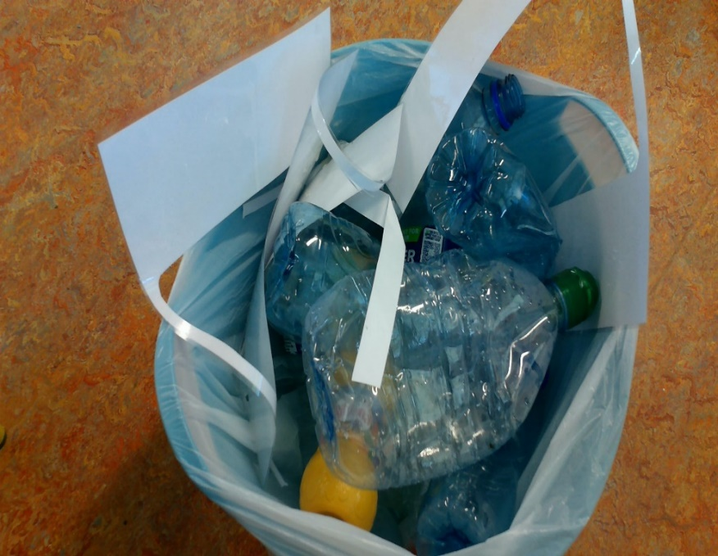
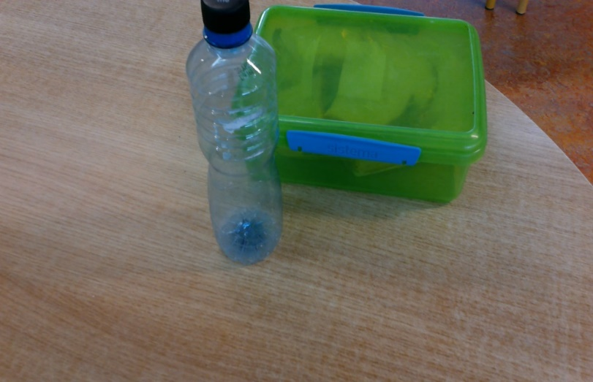
Why Choose This Idea?
Plastic was present all over our school.

Slide 4
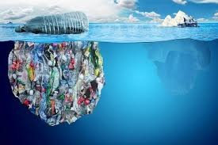
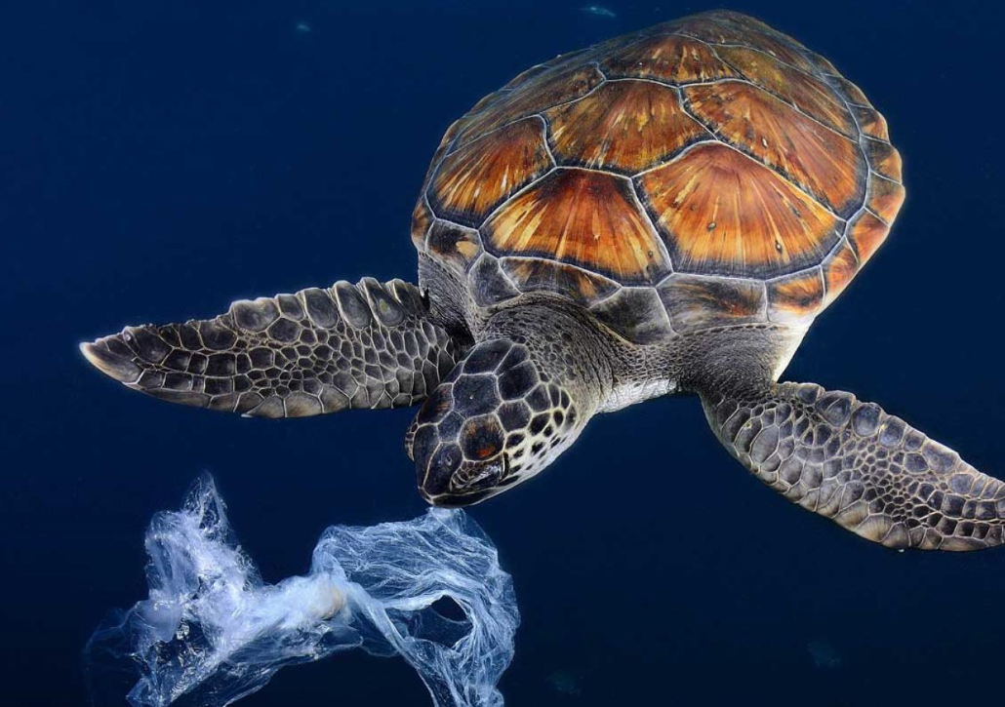
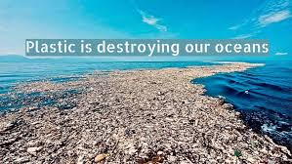
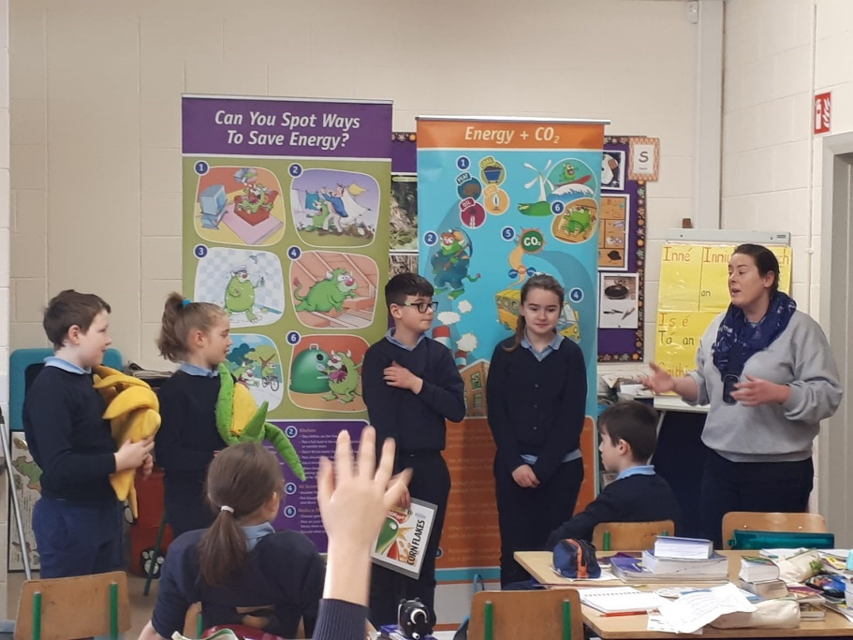
Research
Source: Conserveenergy.com
Source: NatGeo Kids
We carried out an energy workshop.
Source: Paktales.com

Slide 5
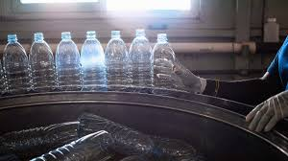
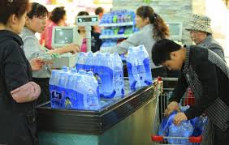
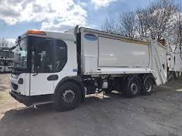
Environmental Impact
Global Warming
85g of carbon produced per 500ml bottle
2,000 bottles used on average per month
School carbon footprint = 1700g per month

Slide 6
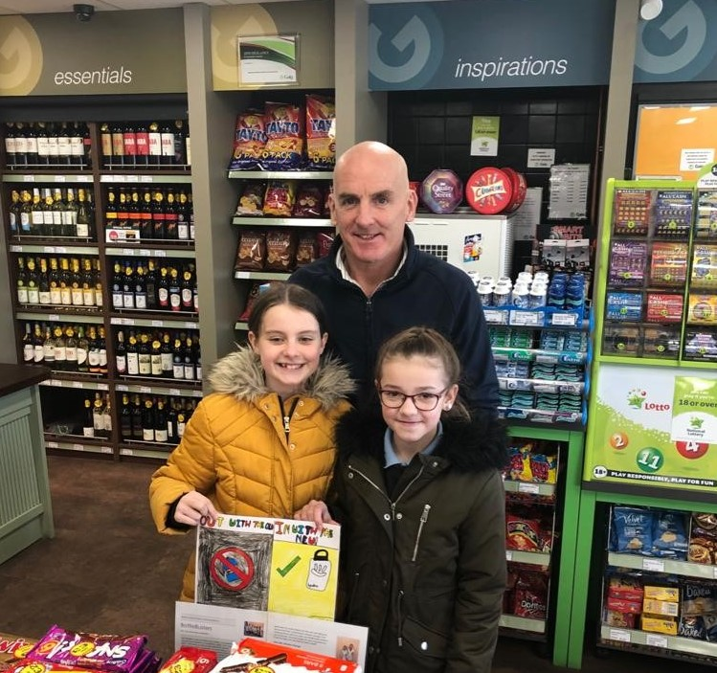
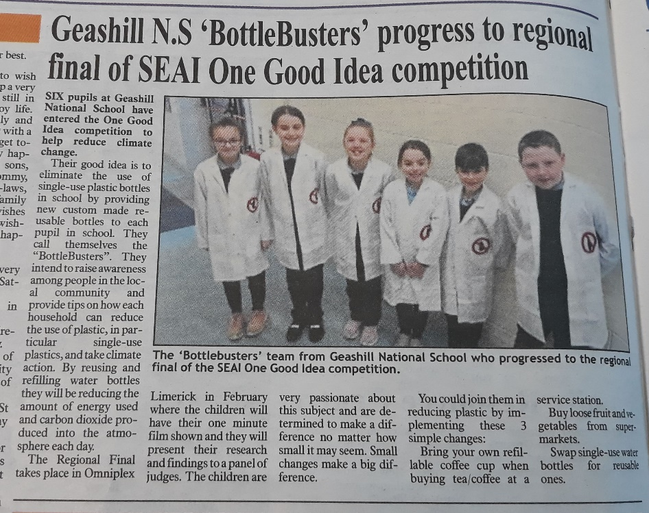
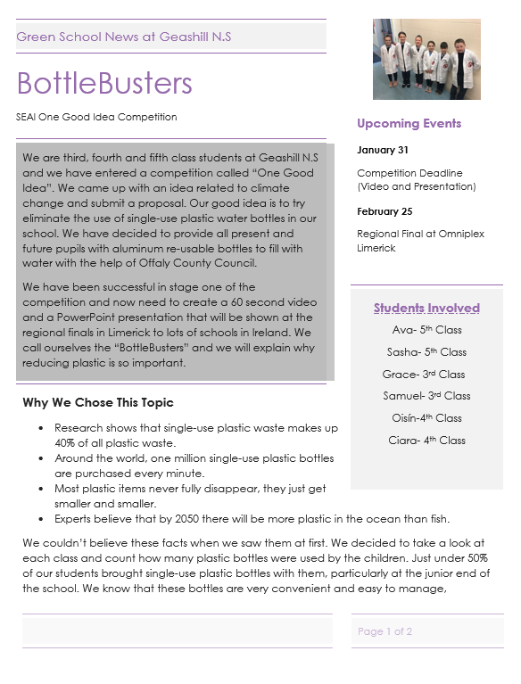
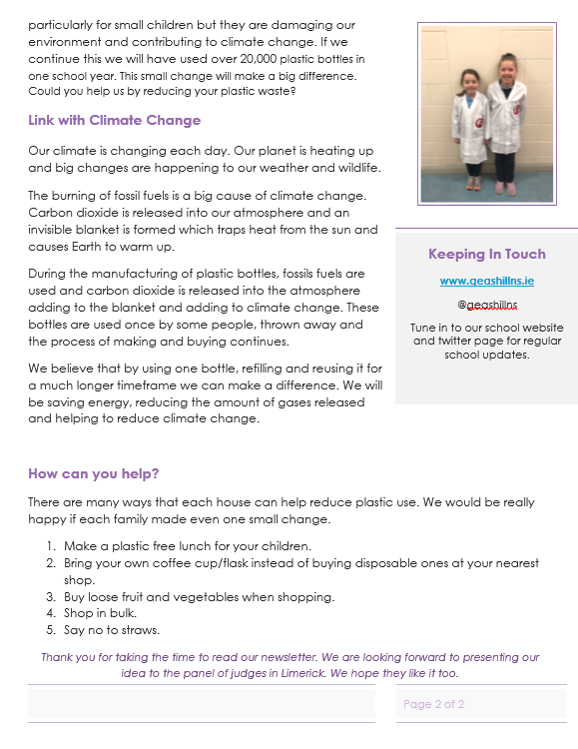
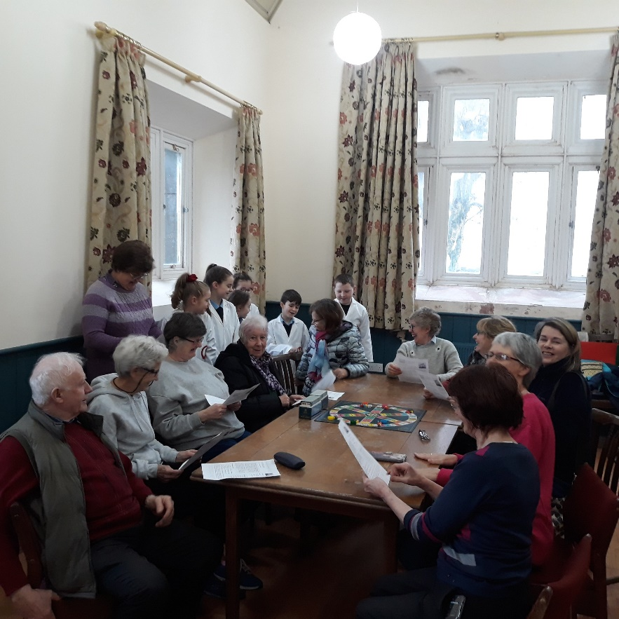
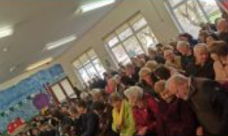
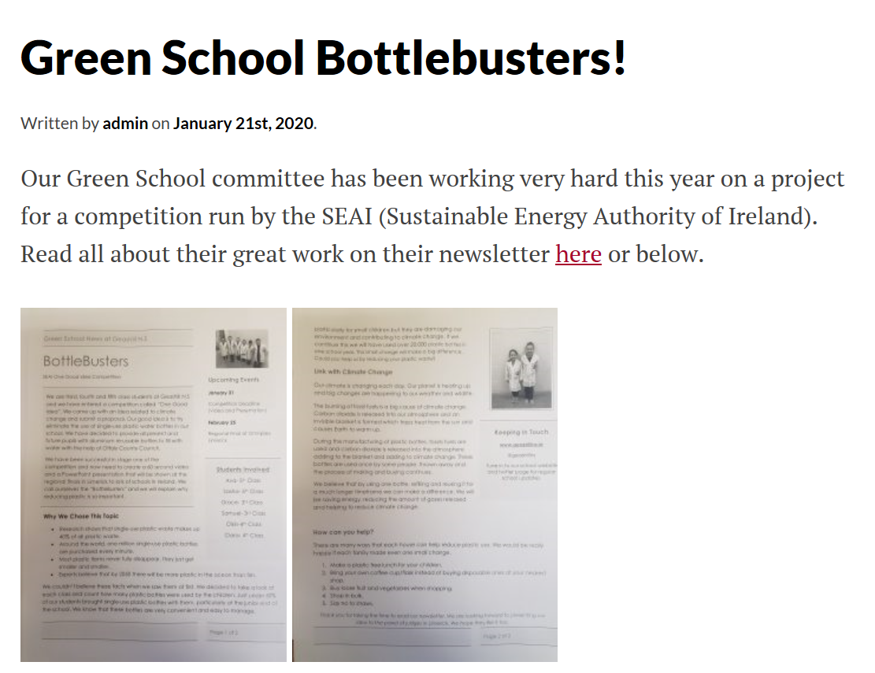
Promotion
Newsletters & Posters
School website
Twitter page
Local clubs
Local shop
Newspaper
Grandparents’ Day
Total Outreach = 12000+

Slide 7
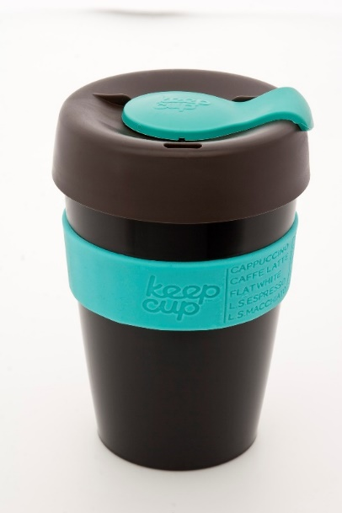
You Can Make A Difference Too
Bring your own coffee cup to the shop.
Buy loose fruit and vegetables.
Buy in bulk.
Choose re-usable water bottles.
Recycle any plastic you may have.
THINK BEFORE YOU CHOOSE PLASTIC

Slide 8
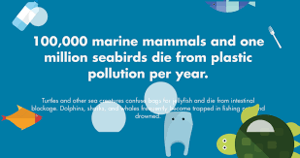
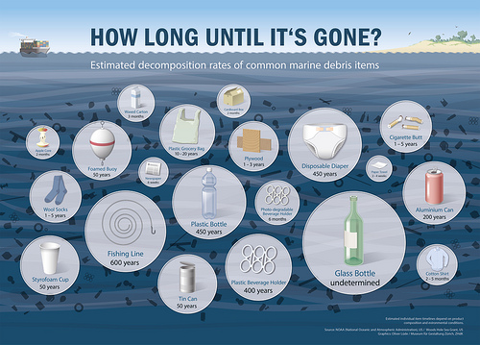
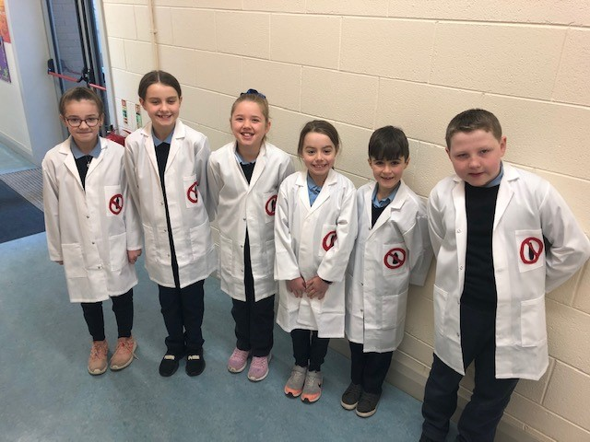
Take Climate Action
Geashill National School has reduced their carbon footprint greatly by making just one simple change. We aim to continue making small changes and encourage you to join us.
1 x 500ml bottle of water = 95c on average
27000 bottles = €25,650 (possible savings over 1 year period)
Think About the Future
PlasticPollution.com
Coalition.org

