Slide 1
Beginning Junior Infants
“Mol an óige agus tiocfaidh sí.”

Slide 2
Welcome!
Welcome to all parents and guardians.
Your child is finally ready to embark on their exciting journey into formal education.
Today’s presentation is here to inform you about what your child will learn in school, what kind of homework to expect, and practical advice to help you support your child as best as you can through their first year of school.

Slide 3
Preparation for School
Please speak positively about school.
Read books and discuss stories with your child.
Take trips to your local library.
Engage in fine-motor control activities: Threading, making jigsaws, play dough, fastening buttons etc.
Show your child how to put on/take off their coat (buttons/zip).
Label all belongings (especially jumpers and track suit tops).
Write your child’s name on the outside of all books.
Shoes - Velcro/no laces if possible.

Slide 4
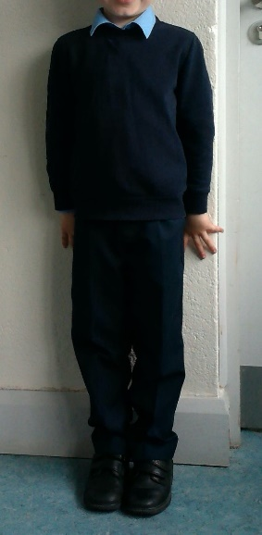
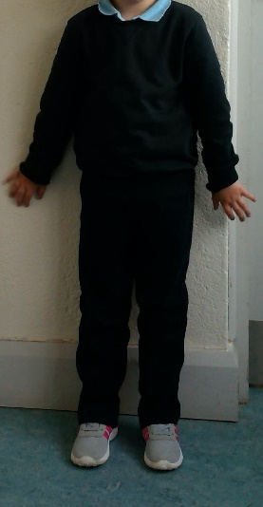
School Uniform
Navy Jumper/Cardigan
Blue shirt
Navy trousers/skirt/pinafore
Black shoes (Velcro)
PE Uniform
Navy tracksuit
Blue t-shirt
Navy jumper
Runners (Velcro)
Label all uniform items please

Slide 5
Lunch
Break time: 11:00 - 11:10 & Lunch time: 12:30 - 13:00
Not too much lunch, as it takes a long time to eat and children can get overwhelmed.
Healthy Lunches - We have a healthy eating policy in Geashill N.S. All children are encouraged to bring healthy lunches to school. One small treat is permitted on Fridays.
If fruit/vegetables are brought for lunch, ensure they are prepared in a way that your child can manage independently.
Bottles of water can be refilled in the classroom.

Slide 6
Curricular Work
English Reading, Writing & Oral Language. (Jolly Phonics & Starlight Programme)
Gaeilge (Bua na Cainte A)
Maths (Planet Maths)
Social Environmental & Scientific Education (S.E.S.E)
Art
Music
Drama
P.E.
Social, Personal & Health Education (S.P.H.E)
Religion (Grow In Love Primary 1).

Slide 7
Aistear
Aistear is a curriculum framework for children from birth to 6 years old. Aistear is the Irish word for a journey.
It is not a separate subject but a way of teaching every subject. It places an important emphasis on learning through play.
This play is structured play, designed carefully by the teacher. It consists of various stations such as role play, small world play, messy play, construction, junk art etc.
New vocabulary will be taught before beginning each new theme. The children are encouraged to use this language in context during Aistear time.
A new theme will be explored every few weeks: travel, the supermarket, the restaurant etc.
It strives to make children’s learning relevant to their own lives and experiences.
The adult guides the children in their learning. You, as a parent, also play a hugely important role in this.

Slide 8
Phonics
Children are now taught to read using phonics.
The children are taught 42 letter sounds. Each sound has a story, song and action to accompany it.
Letter names become more of a focus at a later time.
Reading is taught using a ‘blending’ technique, where children are taught to ‘blend’ sounds together. For example, c-a-t, b-a-g.
Words that cannot be sounded out (also known as ‘tricky words’, such as ‘the’, ‘our’, ‘he’ and ‘she’), are given to the children to learn by sight. It is important to practise tricky words with your child each night.

Slide 9
Homework
Should take 10-15 minutes with no distractions.
Each child will have a zipped homework folder. Notes for home will be put in the folder. If you wish to send in a note, put it in the folder and make it visible.
Homework sheets will be given out each Monday. They will explain what has to be done for the upcoming week.
The children will receive a new rhyme/poem each week to read, one maths activity sheet and some phonics based homework. Reading will begin after Christmas.
Phonics exercises/maths will always relate to topic being covered in class that week.

Slide 10
Settling In
School begins at 9.20am. The bell is rung at 9.15am outside and children line up accordingly before walking to the classroom.
The children can come straight into the classroom on week 1 and sit where they please.
You’re welcome to come into the classroom for the first day or two and slip away as soon as your child is settled.
Seating places will be changed every few weeks to ensure the children get a chance to know everybody in the class.

Slide 11
Assessment
Continuous informal assessments will be carried out throughout the year at regular intervals - (Jolly Phonics/Planet Maths/Gaeilge/Fine & Gross Motor Control etc.)
Parent - teacher meetings held in Term 1 (Nov)
Standardised reading tests in Senior Infants (M.I.S.T Middle Infant Screening Test)
If you have any concerns throughout the year regarding your child's progress please arrange a meeting.
If your child is/has accessed ANY early intervention
services please make us aware as soon as possible.
(Speech and Language Therapy/ Physical or Occupational Therapy/ Psychological Services/ Hearing or Vision Services)

Slide 12
Dates for your Diary
School begins on Monday September 2nd @ 9.20am
Week one: 12:00pm finish.
Week two onwards: 2pm finish.
Children must wait behind school gates until a parent/guardian/minder approaches.
If you require somebody different to collect your child please inform me by note or phone the school in advance.
You are all very welcome to attend our annual open day on Friday the 14th of June at 1pm.

Slide 13
Thank You
Thank you for your time. I am looking forward to teaching
the children in September. If you have any question in the meantime do not hesitate to make contact.

