Slide 1
Australia
FACTS ABOUT AUSTRALIA

Slide 2
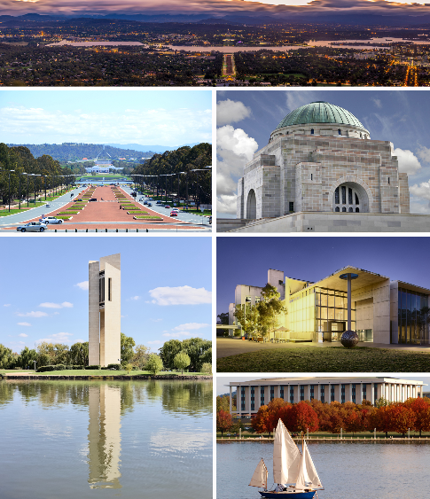
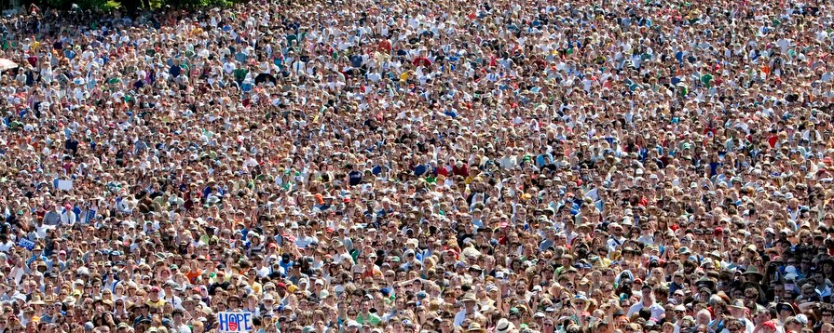
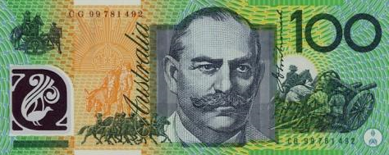
Key Information
Population: 24.8 million
Currency: Australian Dollar
Capital: Canberra

Slide 3
Flags
Australian Flag
Aboriginal Australian Flag

Slide 4
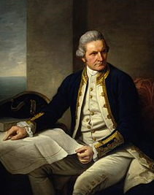
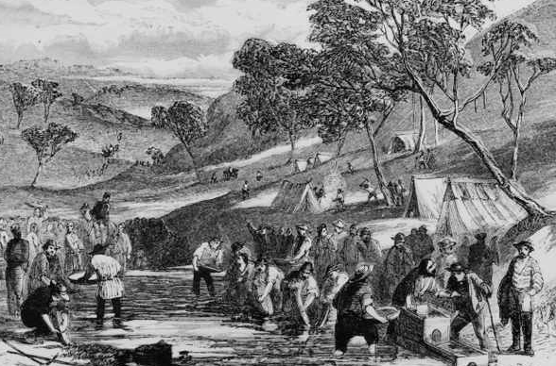
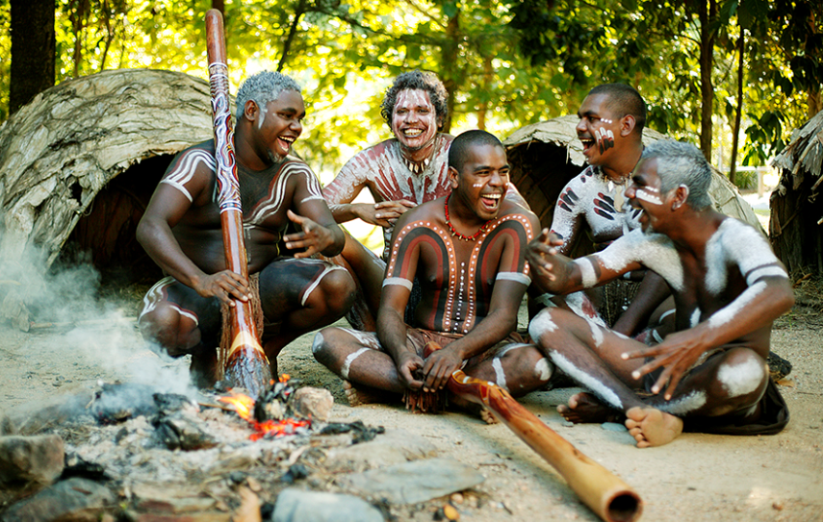
Brief History
People (the Aborigines) have lived in Australia for about 50,0000 years. James Cook discovered Australia in 1770. criminals were sent there because there was not enough room in the English jails.

Slide 5
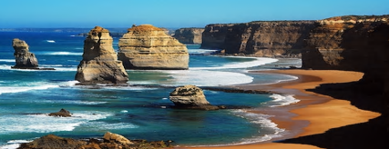
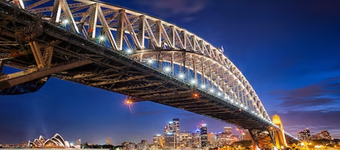
Tourist Attractions
The Great Ocean Road, Victoria.
Sydney Harbour Bridge, New South Wales

Slide 6
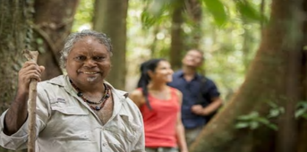
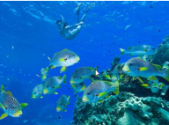
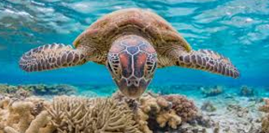
Tourist Attractions
Ngadiku Dream Time Walk, Queensland
Great Barrier Reef, Queensland

Slide 7
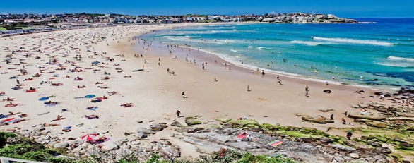
Tourist Attractions
Uluru, Northern Territory
Bondi Beach, New South Wales

Slide 8
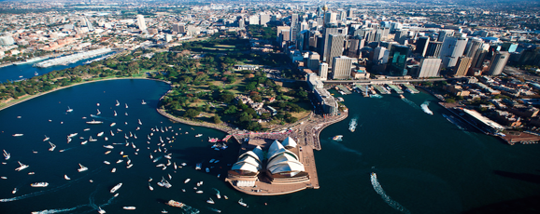
Tourist Attractions
Sydney Opera House, New South Wales

Slide 9
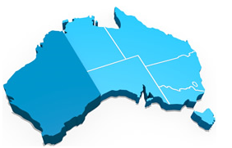
States & Cities
Western Australia

Slide 10
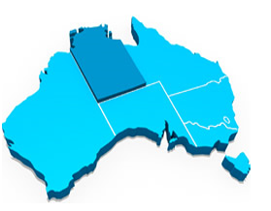
States & Cities
Northern Territory

Slide 11
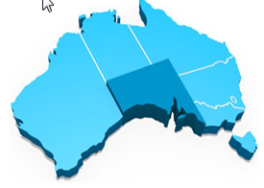
States & Cities
Southern Australia

Slide 12
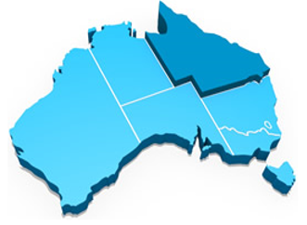
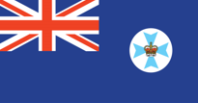
States & Cities
Queensland

Slide 13
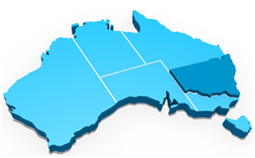
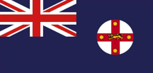
States & cities
New South Wales

Slide 14
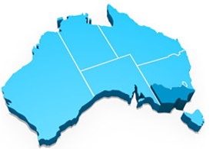
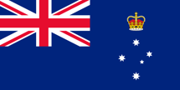
States & cities
Victoria

Slide 15
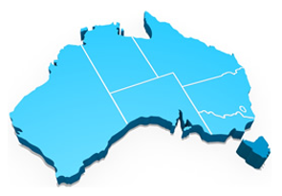
States & Cities
Tasmania

Slide 16
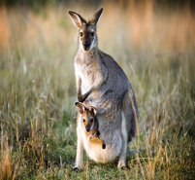
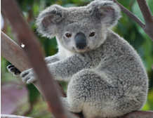
Animals
Kangaroo
Koala

Slide 17
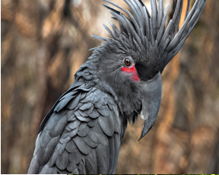
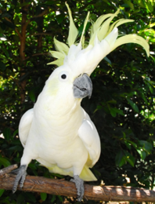
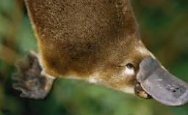
animals
Platypus
Cockatoo

Slide 18
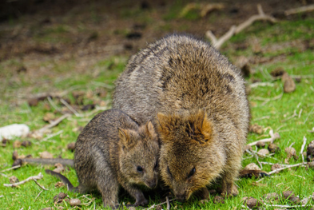
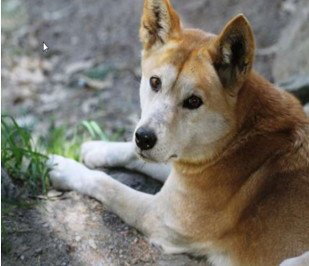
animals
Dingo
Quokka

Slide 19
The end
By Tadhg Lee

Slide 20
Seriously the end

Slide 21
No more after this

