Slide 1
Space
By rihanna,adam and muireann

Slide 2
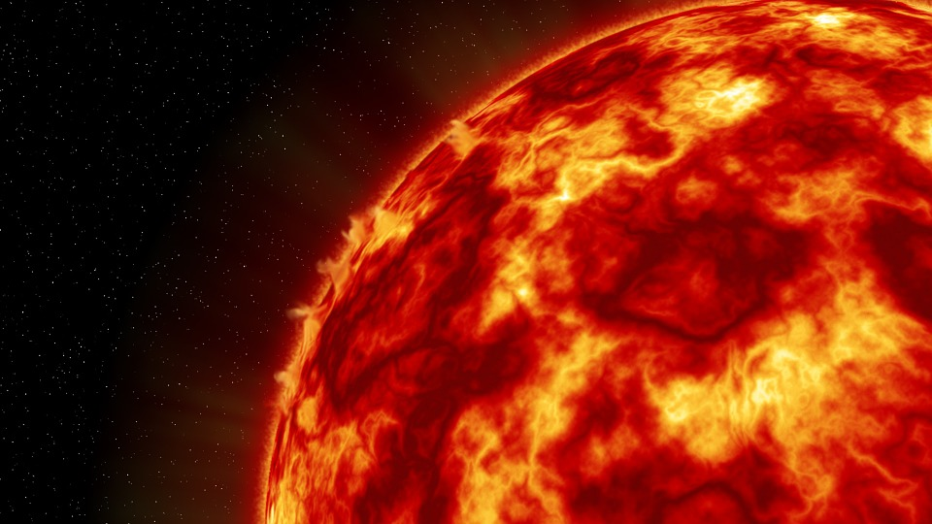
The Sun
The Sun’s core is around 15 million degrees Celsius.
It is over one million times bigger than the earth and 300,000 times heavier.
The Sun has a staggeringly powerful gravity force which pulls the planets in in space towards itself.
The Sun is 150 million km/away from the earth.
It takes the Sun’s light just over 8 minutes to actually reach the earth.

Slide 3
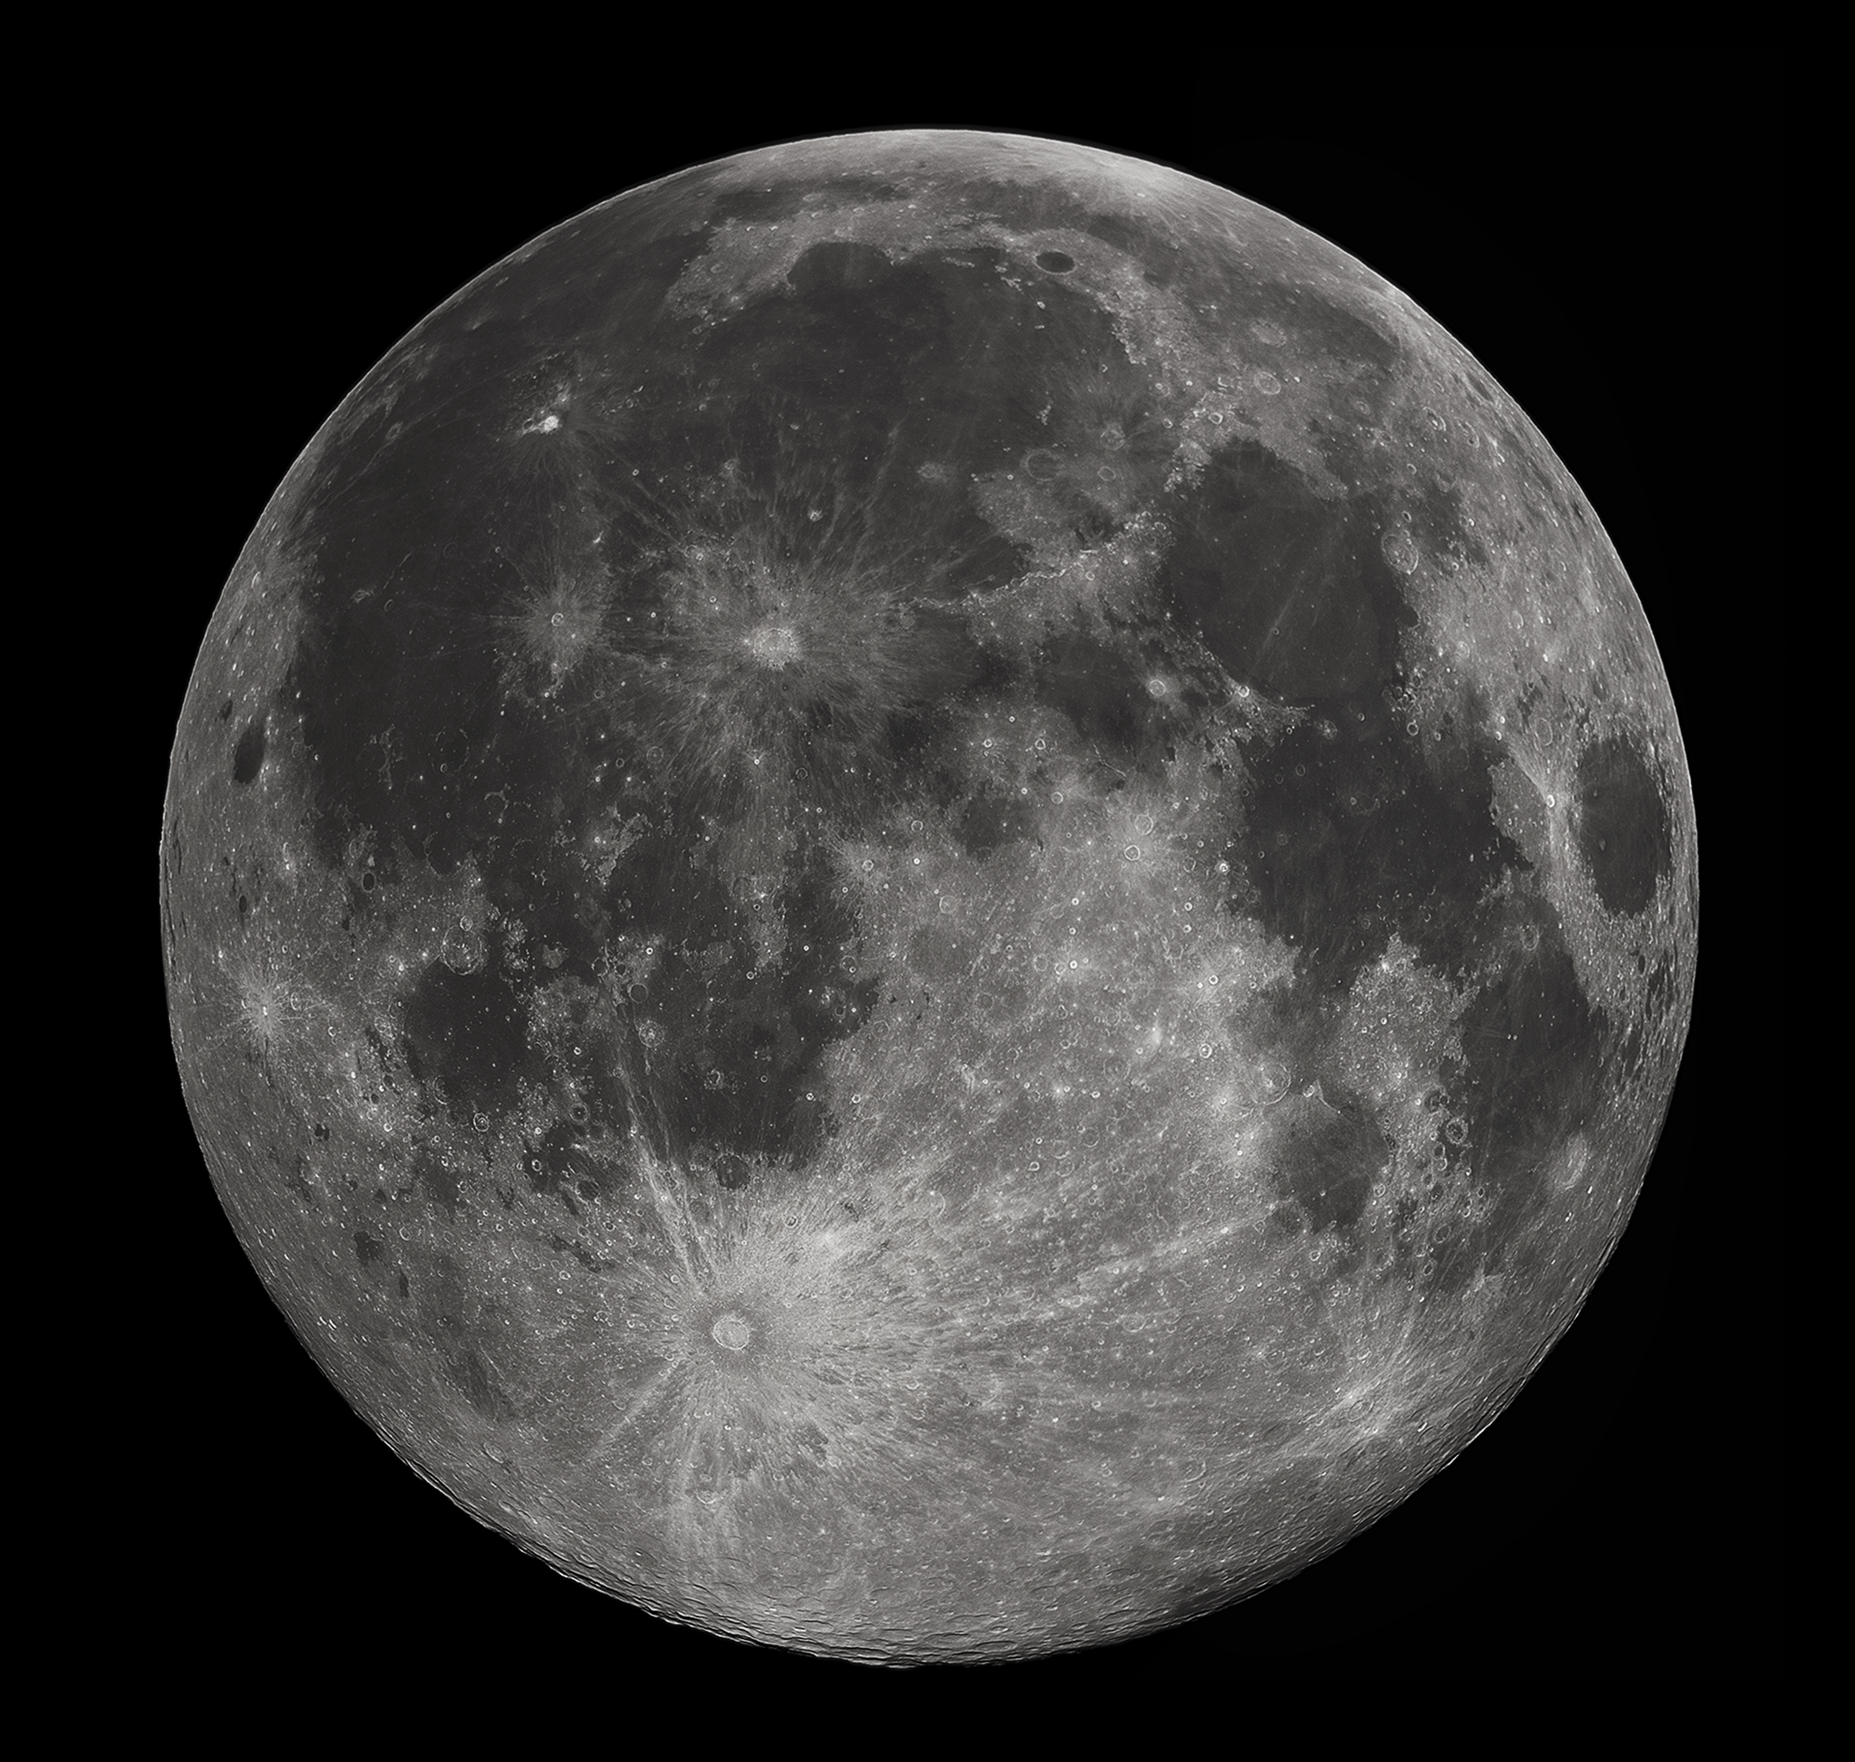
Mercury
Mercury is the planet closest to the Sun.
It takes 88 days to orbit the Sun.

Slide 4
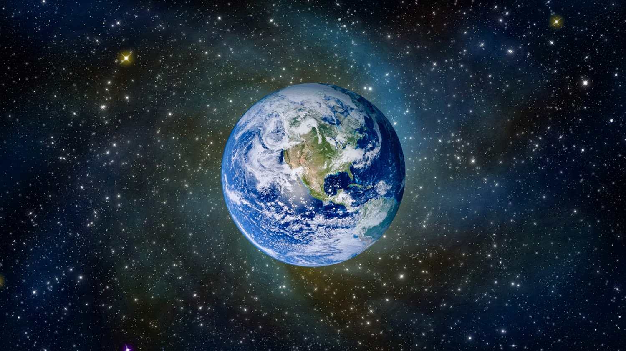
Earth
The earth is the largest of the four rocky planets. It is made of several layers.
The core is at the centre. Outside the core is the mantle, and the surface is called the crust.

Slide 5
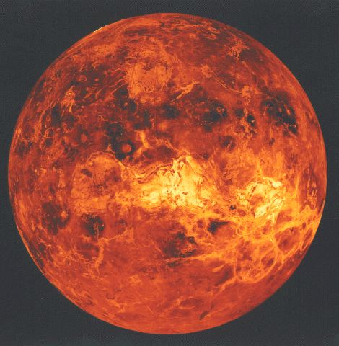
Venus
Venus is often called our twin planet because it is very similar in size to the earth, but it is waterless.
It is also know as the evening star because it is often the first star we see shining in the sky as darkness falls.

Slide 6
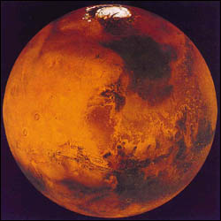
Mars
This planet is known as the Red Planet because of its colour.
Mars is a rocky planet with two small moons.

Slide 7
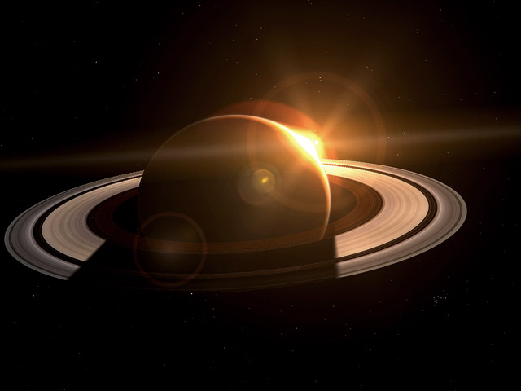
Saturn
Saturn is the second largest planet and it has at least 18 moons.
Bright shining rings surround this gas planet.
It is the lightest of all the planets.

Slide 8
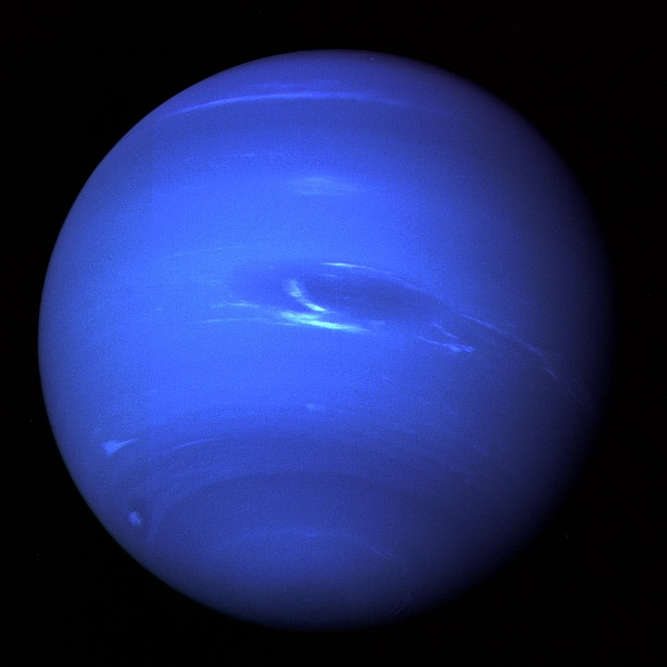
Neptune
Neptune is a blue planet with white clouds.
Methane gas creates its blue colour.
Neptune was discovered in 1846. It has 8 moons.

Slide 9
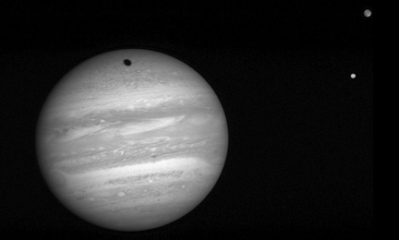
Jupiter
Jupiter is the largest planet in our solar system.
Jupiter is a gas planet with 16 moons of its own.
It spins 30 times faster than the Earth.

Slide 10
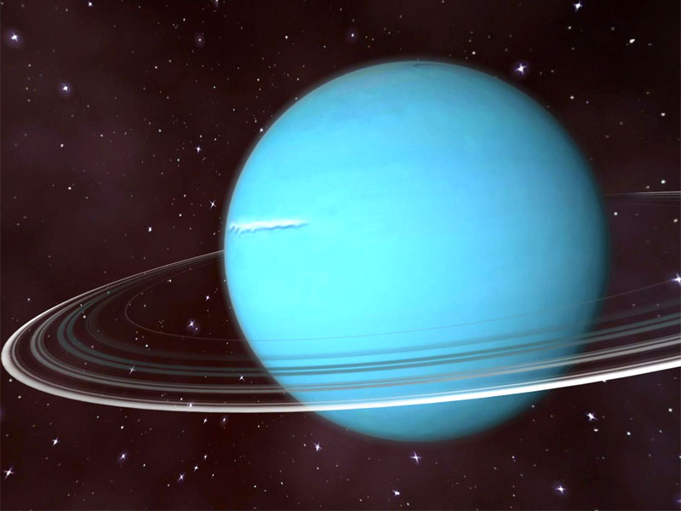
Uranus
Uranus is a planet made of gas and is tipped on its side.
It was discovered in 1781 after the invention of telescopes.
Uranus has 15 moons.

Slide 11
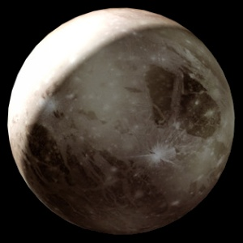
Pluto
Pluto is the farthest planet from the sun.
It is made of ice and rock.
It was discovered in 1930.
Pluto has 1 moon.
It takes Pluto 248 of our years to orbit the Sun.

